Slide 1
Mineralogy

Slide 2
A mineral is a naturally occurring solid with a highly ordered atomic arrangement a definite (but not always fixed) chemical composition and is usually formed by inorganic processes

Slide 3
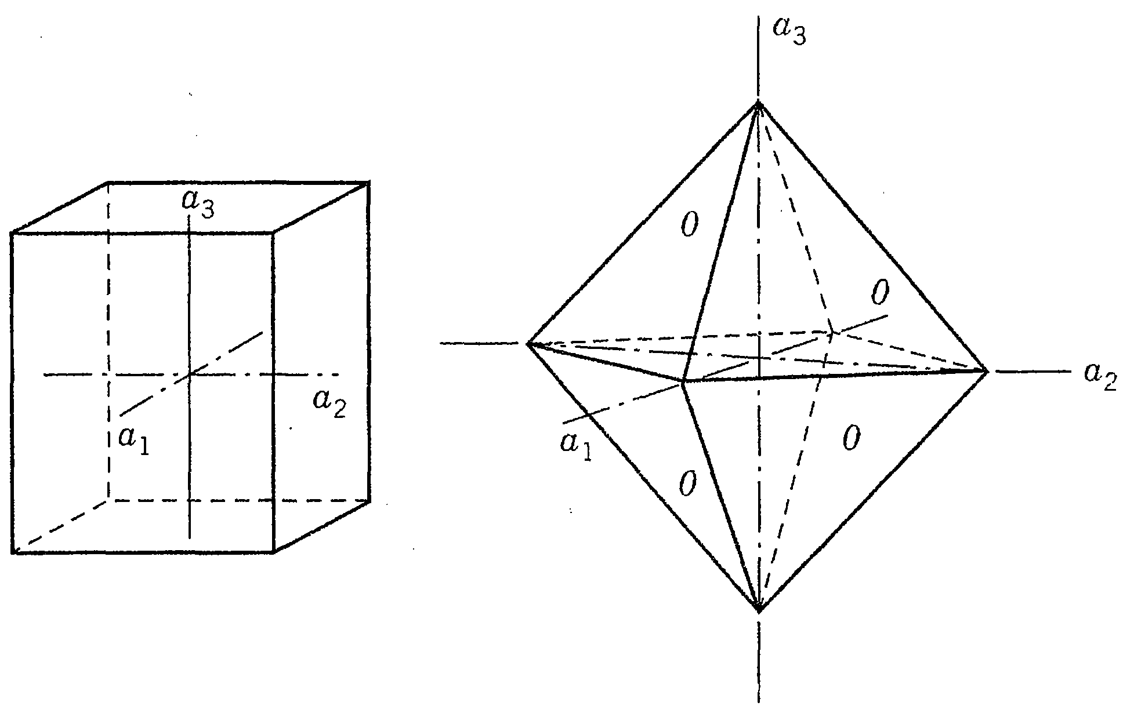
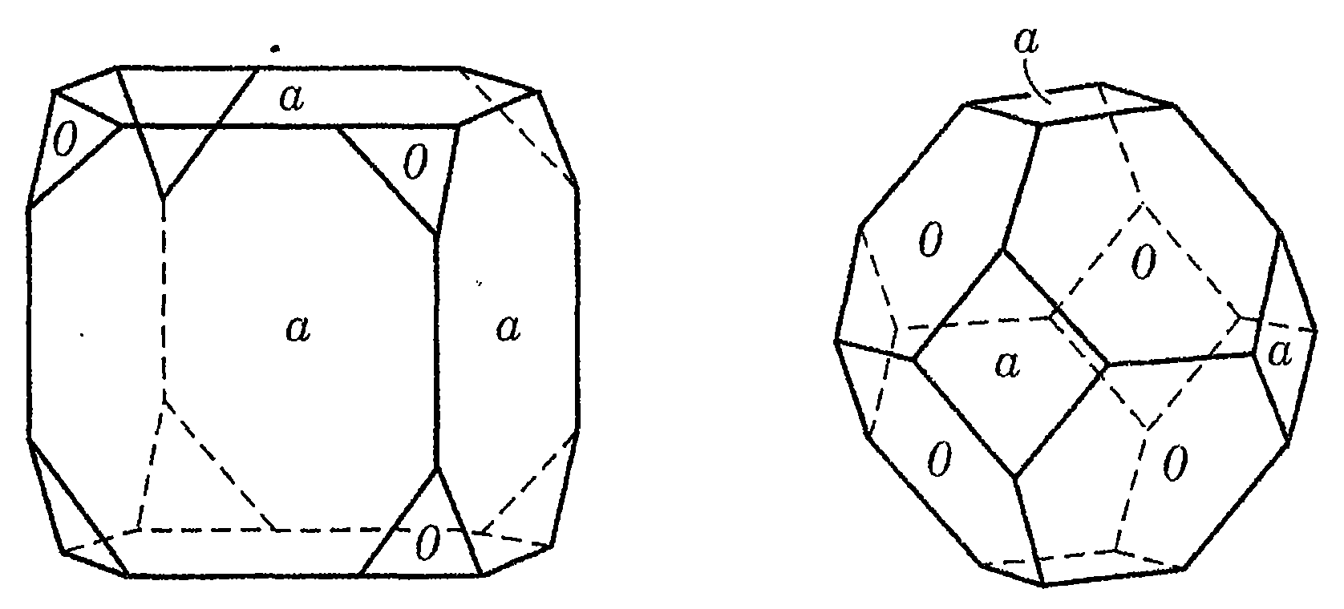
Crystal Habit
The regular geometric shape

Slide 4
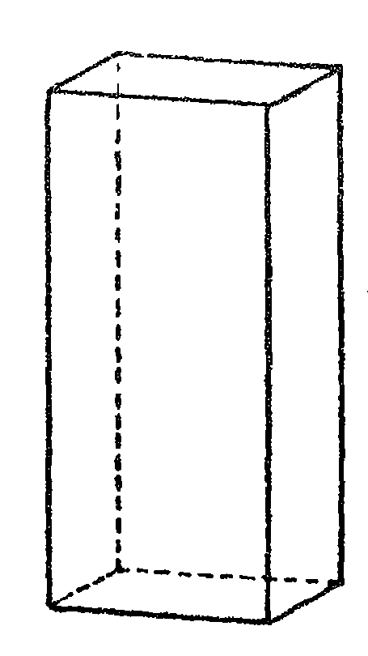
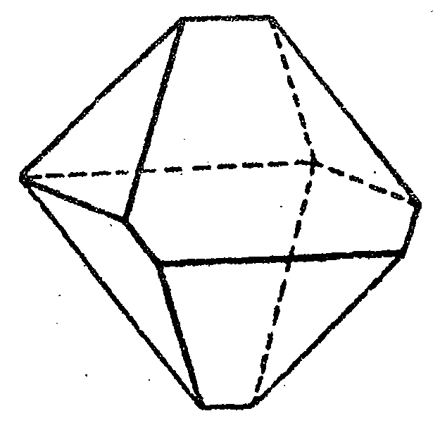
In Reality
Asymmetric Octahedron
Malformed Cube

Slide 5
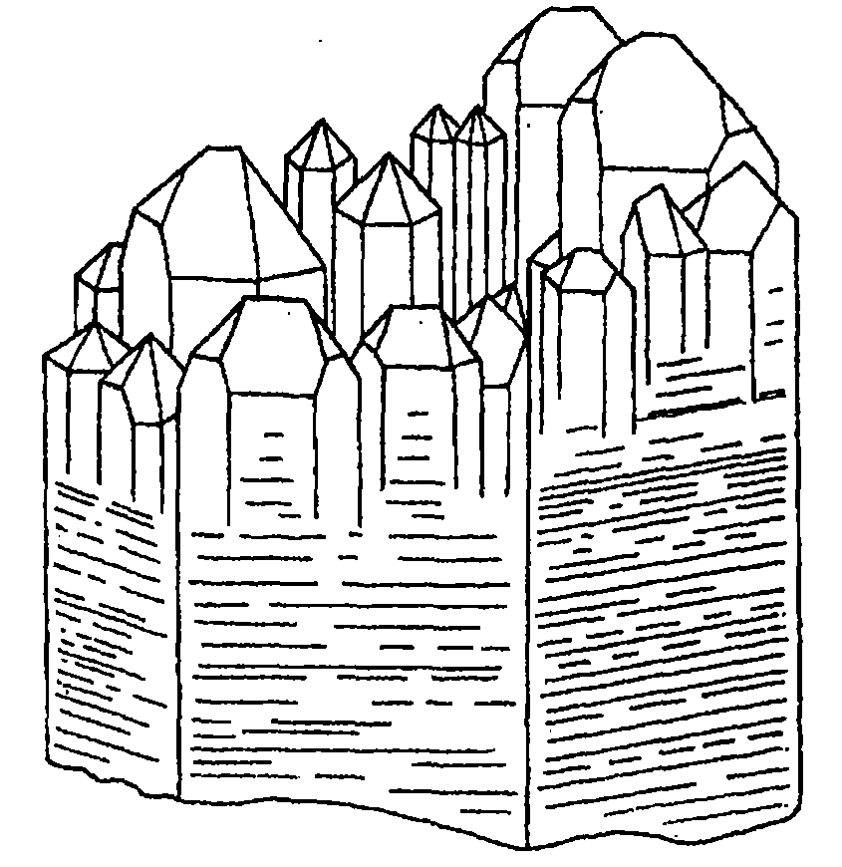
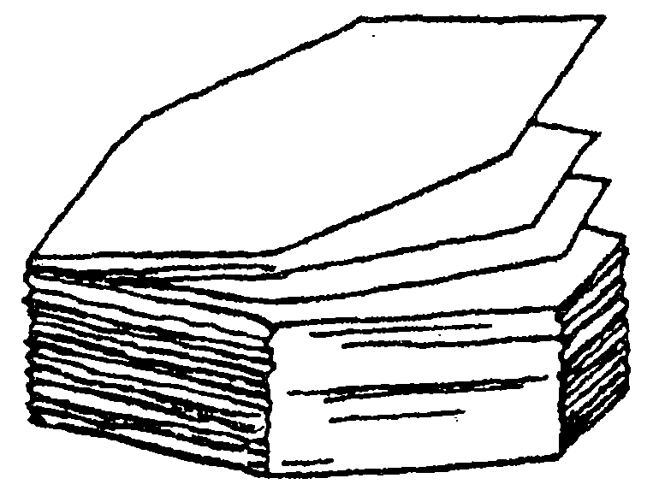

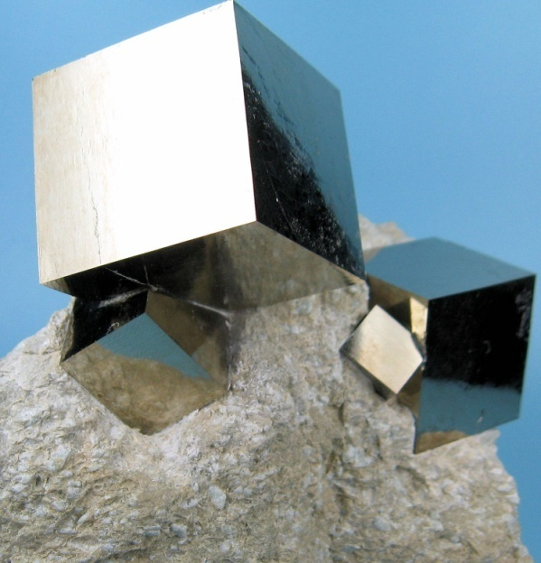
Most minerals occur as aggregate of grains (but having internal order as evidenced by optical properties and X-ray diffraction)
Parallel growth in quartz

Slide 6
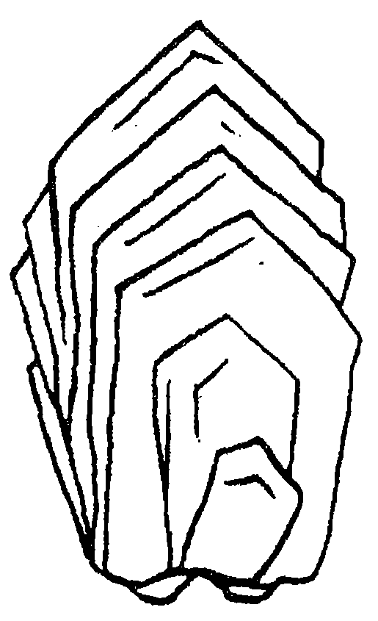
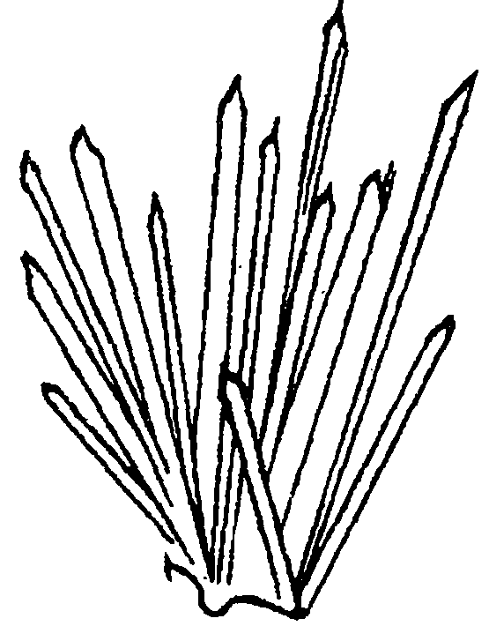

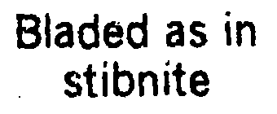
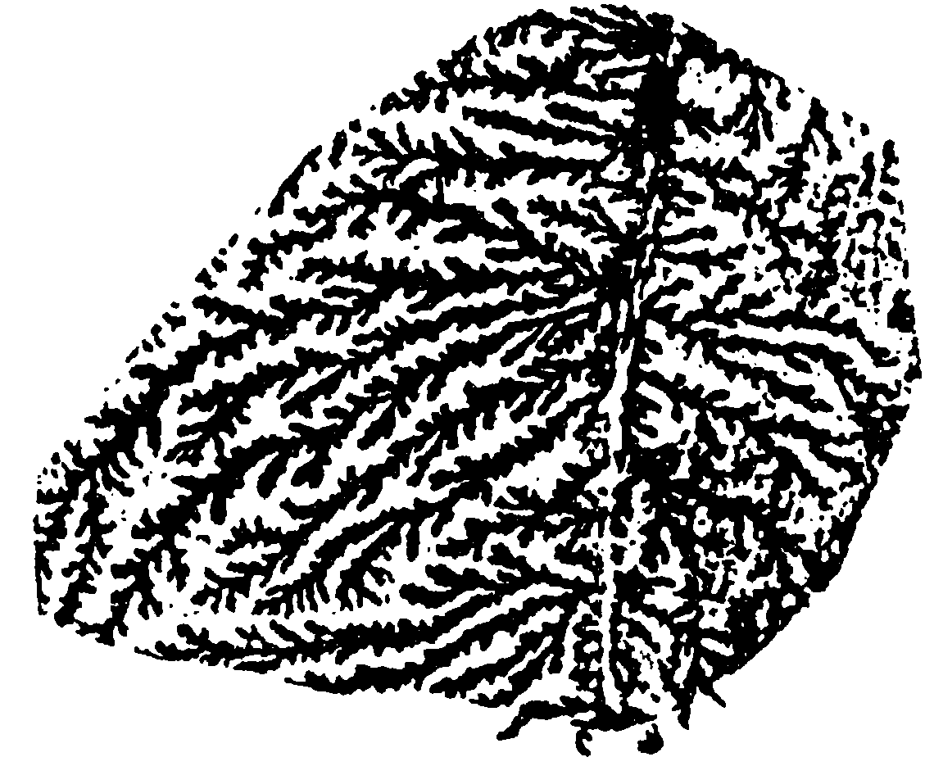
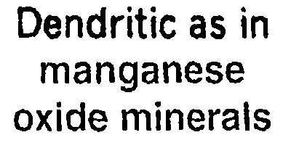

Slide 7
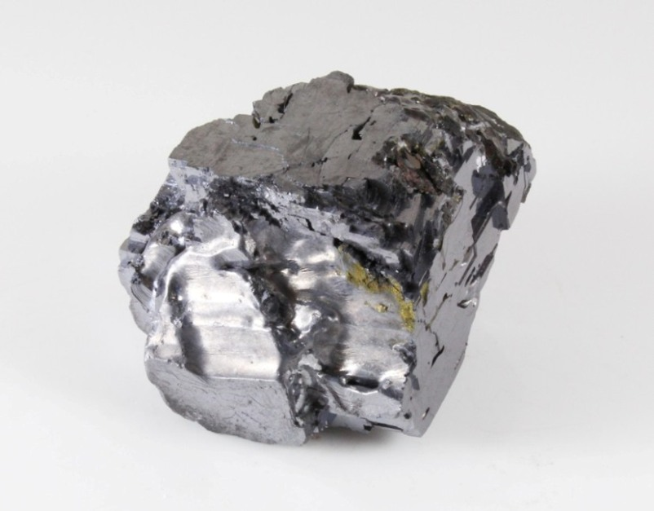
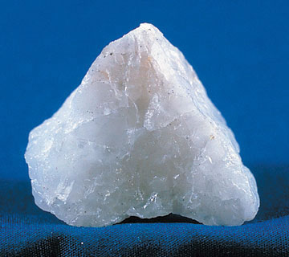
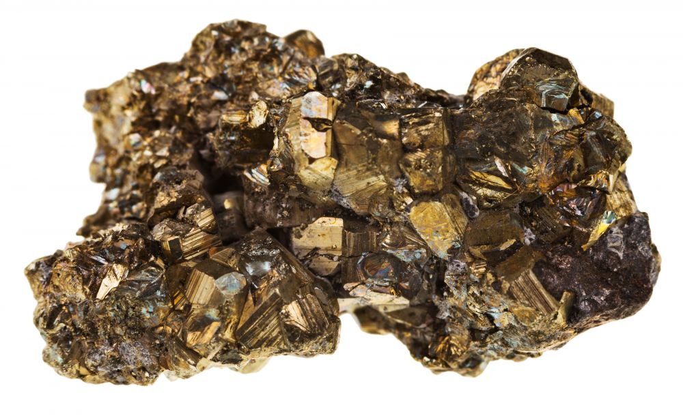
Luster: General appearance of minerals in reflected light
Metallic (Galena, Pyrite, Chalcopyrite)
Non-metallic
Vitreous
Resinous/Waxy
Pearly
Greasy
Silk-like
Adamantine

Slide 8
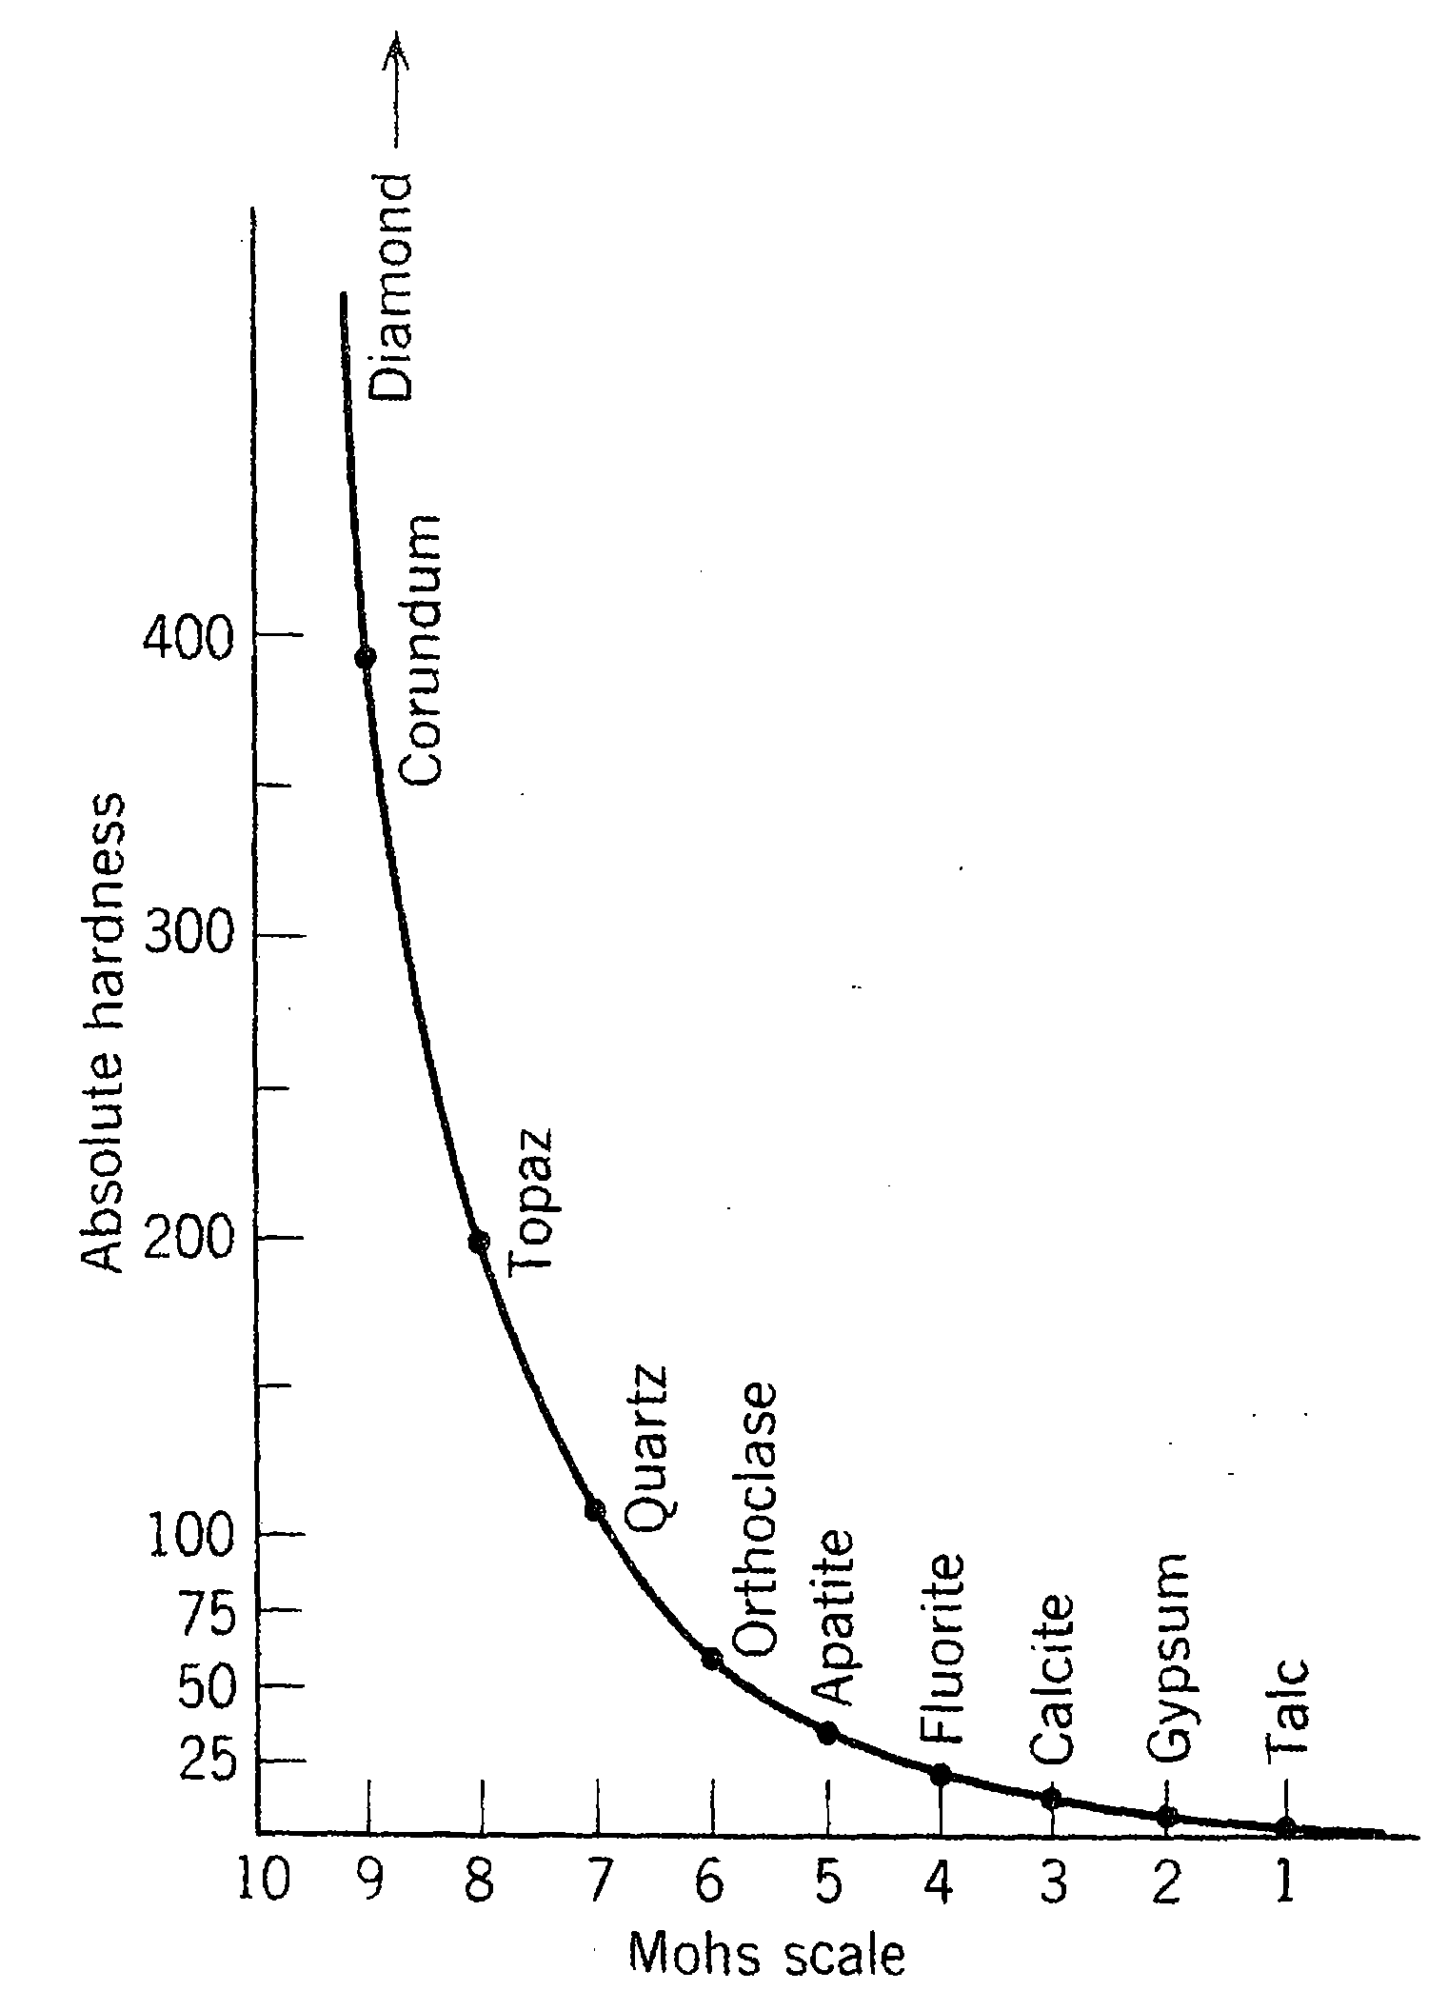
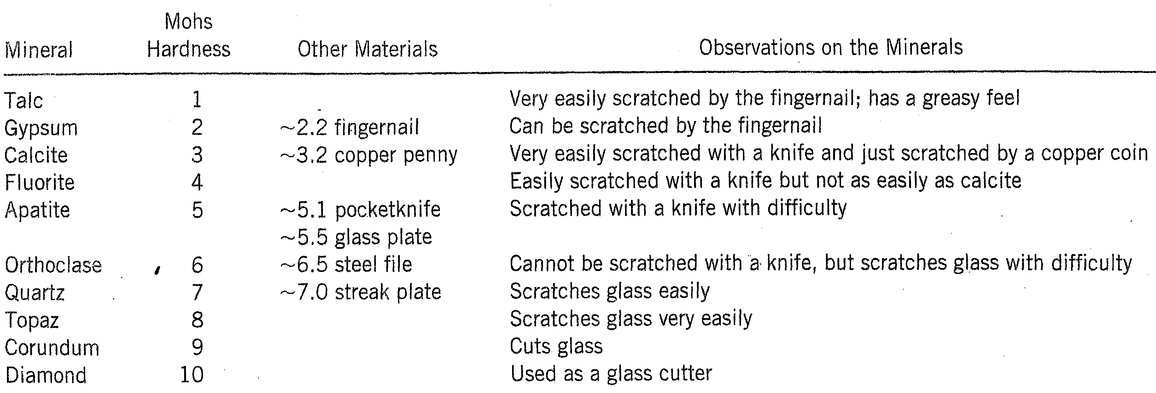
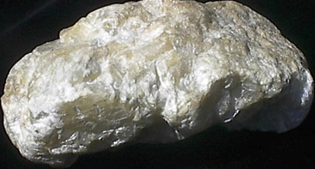
Hardness: The resistance that a smooth surface of mineral offers to scratching
Hardness is a vectorial property

Slide 9
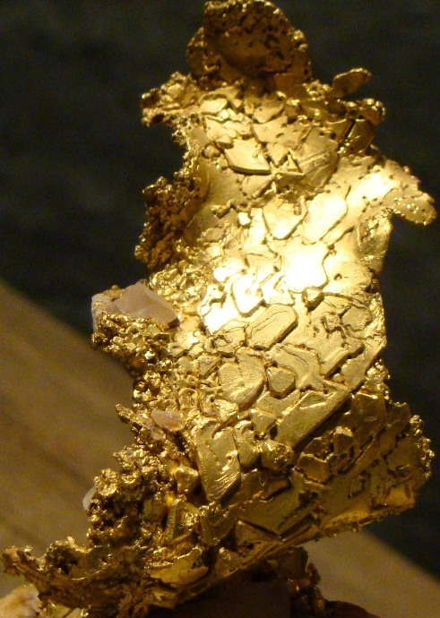
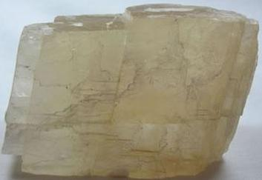
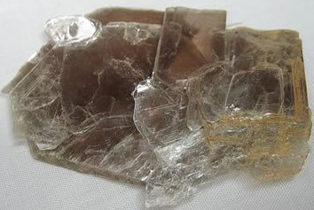
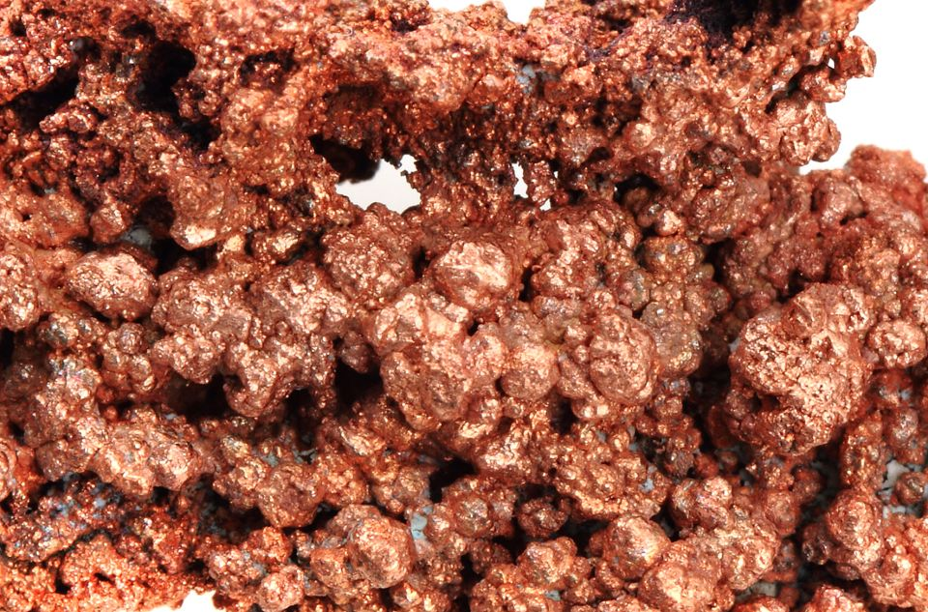
Tenacity: The resistance a mineral offers to breaking, crushing, bending or tearing
Brittle
Malleable
Ductile
Sectile
Flexible
Elastic

Slide 10
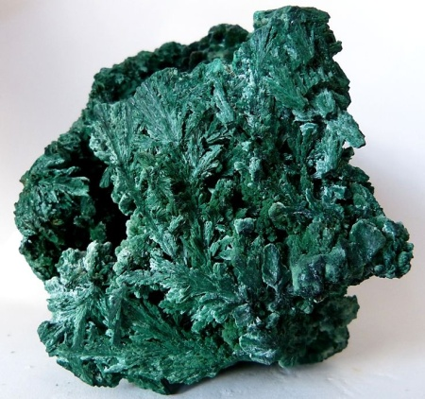
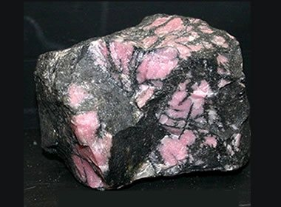
Color (not particularly diagnostic except for a few…) and Streak
Minerals with diagnostic colors:
Malachite
Azurite
Rhodonite
Turquoise
Diamond- the best example for the variability of color
Members of orthopyroxene series (Enstatite to Ferosilite) range from light beige to darker brown
Members of plagioclase feldspar series range from pure white in Albite through light gray to darker gray towards Anorthite end-member

Slide 11
Rock-Forming Minerals

Slide 12
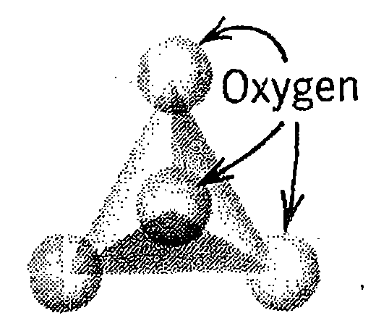
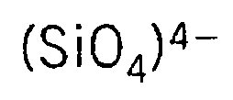
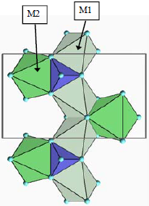


Slide 13
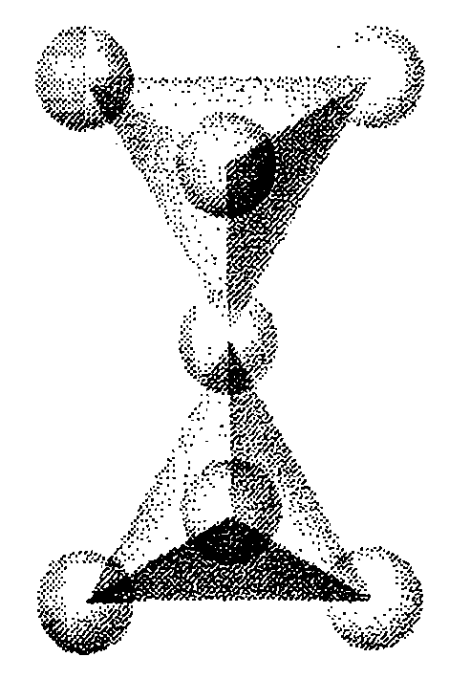
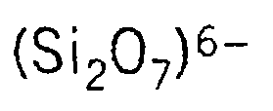


Slide 14
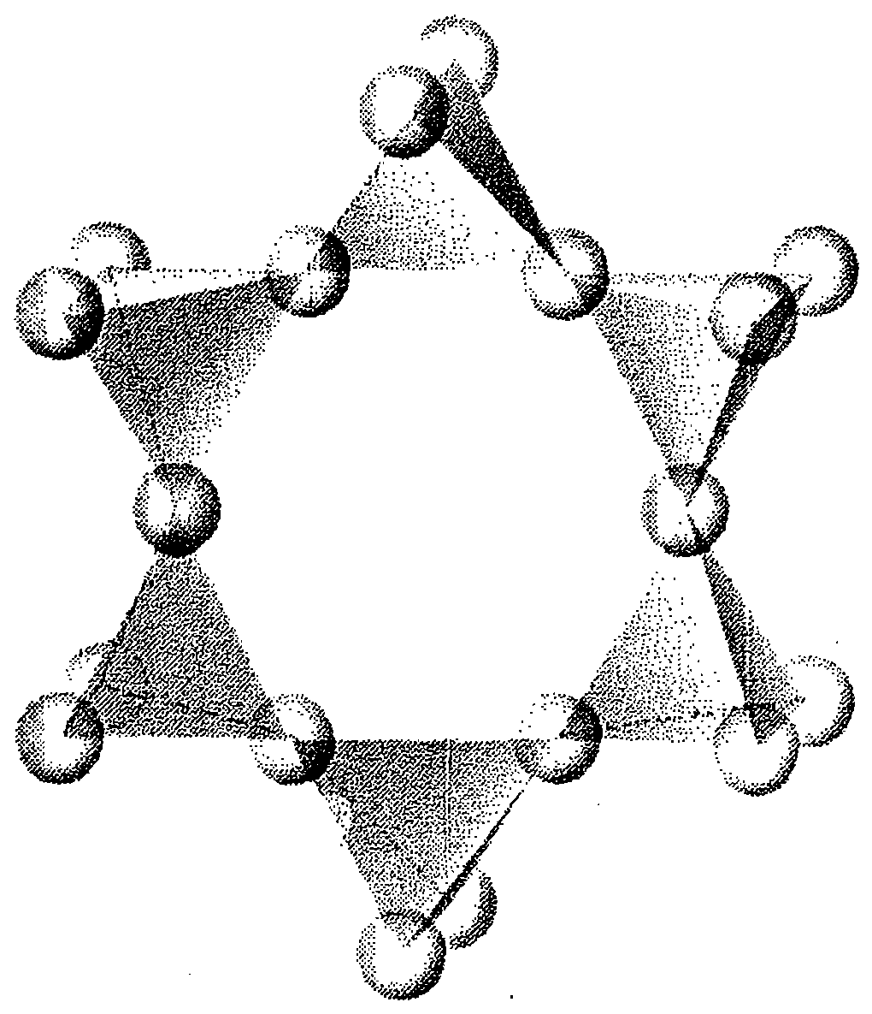
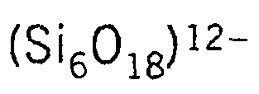


Slide 15
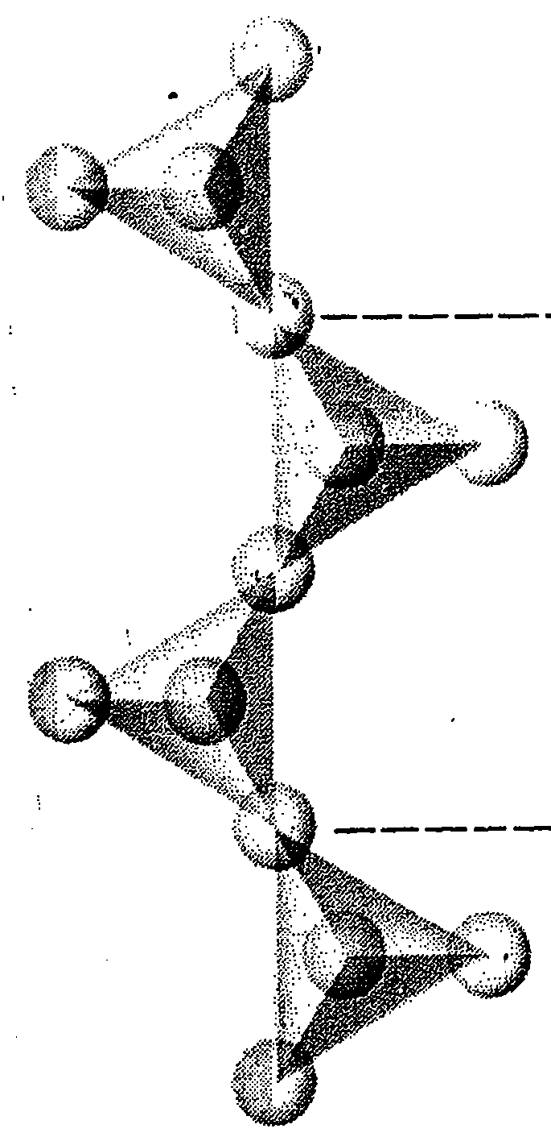
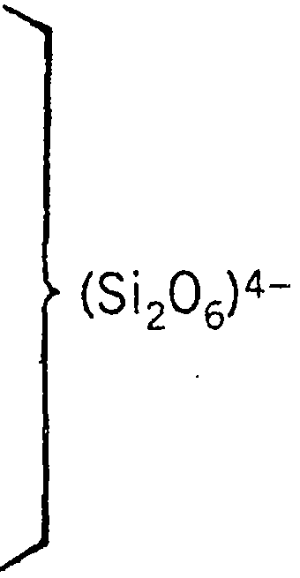


Slide 16
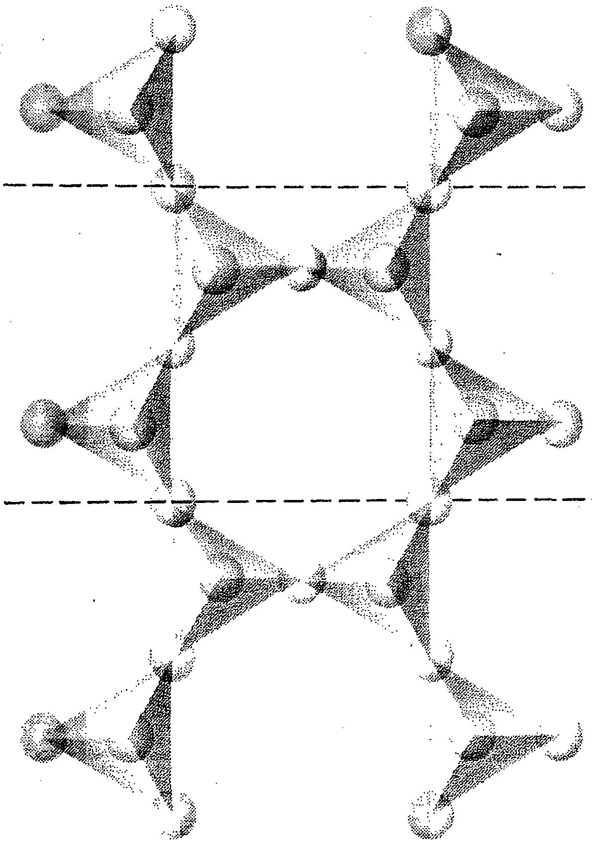
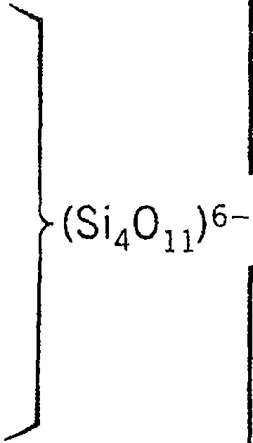
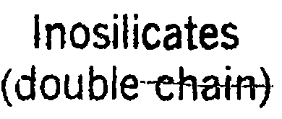

Slide 17
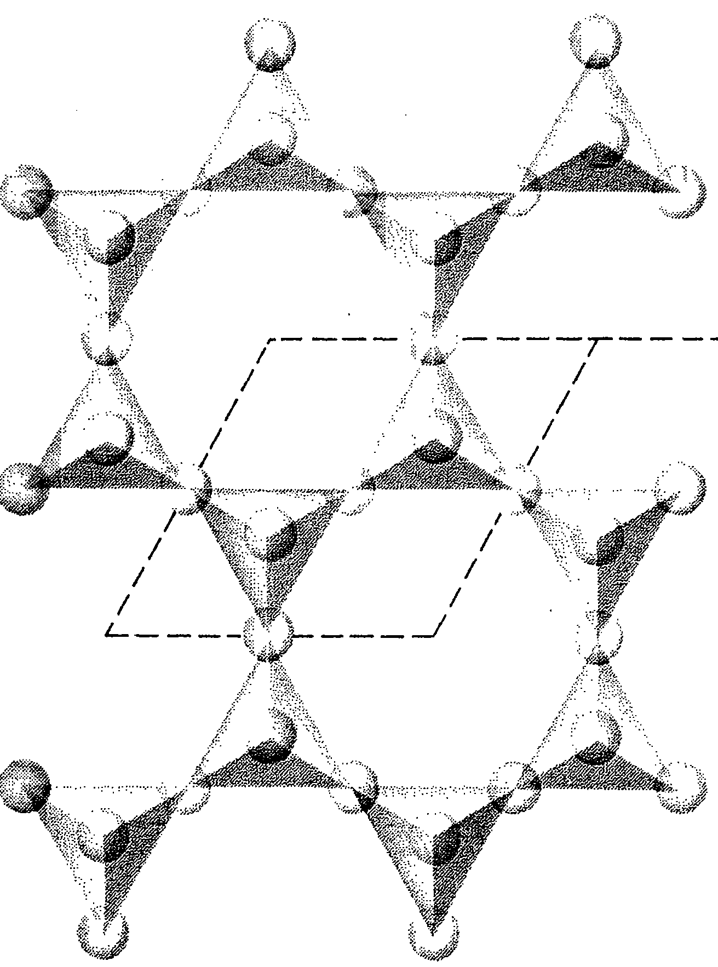

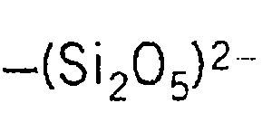
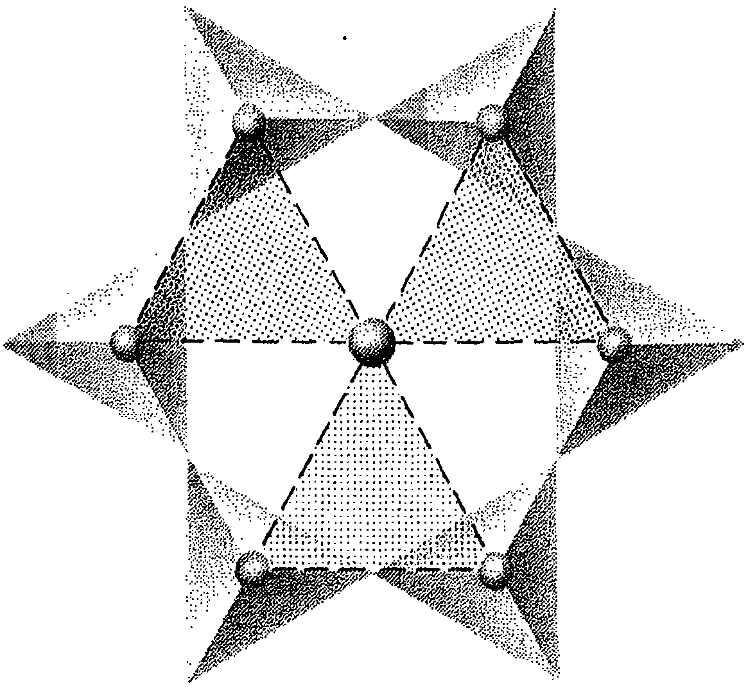
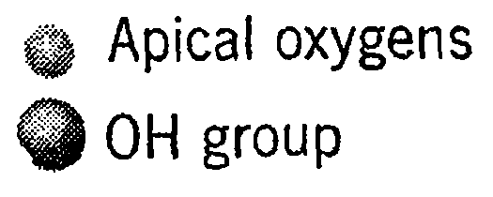

Slide 18
